Slide 1
CampusHash
Group 4
Rohit Petle, Zain Ahmed, Sridhar Karumuri, Srinidhi Ls, Rahul Kotian

Slide 2
Overview
Sanket Saurav and Rohit Tirkey co-created a Indian software training program start-up, CampusHash, in 2012. The goal of CampusHash was to teach students new software areas such as social media, mobile apps, and big-data analytics to better prepare students for the industry. The co-founders felt the need to create CampusHash due to their institute teaching outdated software concepts and were not exposing students to new technologies.
Apart from training, CampusHash was also known for popularizing hackathons where they could monitor participants and help IT companies recognize the best of the batch. This helped them maintain a good reputation and many IT companies would come to them for qualified programmers. CampusHash also charged much less than their competitors which was very popular among students.
In 2015, Iliyas Shirol, an experienced technologist, joined the CampusHash and helped reach new levels of success. CampusHash was now well known for students landing internships and jobs in popular IT companies across India. They were also known to make the hiring process much cheaper and easier.
As time passed, the founders and Shirol were now debating on how to grow the business further. Their two options were to stick to the current business plan or expand rapidly by pivoting.

Slide 3
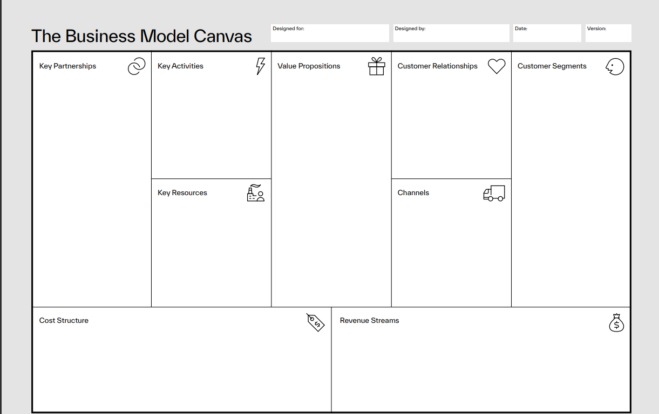
CampusHash Business Model Canvas
IT Company HR
Training - update skills
Conducting Hackathons
Contacts with HR from different companies
Provide skilled interns
Students/ Fresh graduates
Conduct hackathons on companies behalf
College recruiting teams
Reduce time to skill up freshers
Cheaper than competitors
IT Companies looking for fresh graduates
Fresh Graduates
Client Relationships
Workshops
Intellectual Property
Social Media
Small sized companies with not enough experience in evaluating software talent
Hackathons
High quality trainers
Word of mouth
Employees
Sales and Marketing
Revenue from Training Programs
Enrollment Fees
IT companies funding/sponsorships
Training Program Development
Notes:
Use PDF in GroupMe to edit and then upload - https://www.strategyzer.com/library/the-business-model-canvas
1. "Customer Segments" (CS): Describes the many persons or organizations that the company hopes to service.
defines the target market, their demands, and the strategy the company will use to satisfy those needs.
2. Value Propositions (VP): Outline the special benefit the business provides to its clients.
Customers choose one company over another because of it. It meets a need or resolves an issue for the customer.
3. Channels (CH): Indicates the means by which the business conveys its value proposition to its clients.
This can refer to channels for sales, distribution, and post-purchase assistance.
4. Customer Relationships (CR): This describes the kind of connection the business makes with its clients.
It might be automated, self-service, personalized, or a combination of these.
5. Revenue Streams (RS): This indicates how the business makes money from each consumer category.
Sales, subscription fees, licensing, or other fees could be used to fund it.
6. "Key Resources" (KR) is a list of the resources needed to provide the given value proposition. These resources may be material, intellectual, personal, or financial.
7. Key Activities (KA): Outlines the most important steps a business must follow in order to run successfully.
Manufacturing, marketing, sales, and any other crucial tasks could be included.
8. "Key Partnerships" (KP): Lists the external businesses, resources, or endeavors on which the company depends in order to deliver on its value proposition. This can apply to manufacturers, suppliers, or other types of strategic collaborations.
9. Cost structure (CS): This section lists all of the costs and expenses incurred in running the company.

Slide 4
Pivot Options
Recruitment Screening
Problem -
IT companies were having a hard time recruiting good quality engineering talent.
Companies used practical assignments, which were elementary and reused, to assess students.
These assignments would not test the true abilities of the candidates and would cause problems down the road.
Tirkey was against this idea and wanted each company to have a bigger role in judging the candidates performance
Solution -
Saurav wanted to pivot their business model to solve the employee screening needs of IT companies.
He suggested to add a modified version of the hackathon in the recruitment process to help IT companies filter talent.
CampusHash will also have to build a strong B2B sales team and increase their capacity/capabilities.

Slide 5
Recruitment Screening
Benefits:
Low Recruitment: Many companies see recruiting as a burden and do not want to put the effort into properly finding good talent, especially during times of high volume business. CampusHash solves this issue by creating a one-stop type of environment to review candidates abilities.
High Quality Automated Assessment: Provides potential clients/companies the ability to observe their potential employees in an environment that makes sense with the jobs they are hiring for
Employee Screening: Solves overall screening needs for companies that don’t have formal HR Departments/Hiring Managers
Reduces Operational Expenses: Recruiting costs can be a burden on companies and CampusHash solves this problem by reducing costs and offering more candidates per $.
Cost:
Travel Costs: 10,000
Lodging Costs: 5,000
Programming Problems per client: 5,000
Professional Fees: 6,000 per day/event
Revenue: ~100,000 per each client for ~100 Candidates
Assignments/Events: ~16/month

Slide 6
Pivot Options
Outsourced Software Development
Problem -
Tirkey believed that their main strength was to spot other good-quality programmers.
He wanted to leverage this strength beyond recruitment and try to get companies to provide software programming projects to outsource to students to test their skills in real world situations.
Shirol was not convinced as CampusHash was a small company and felt they would not get projects from IT firms.
Solution -
Tirkey believed CampusHash would break each project into smaller problems and use students to solve them during the hackathons.
CampusHash could get the real software solutions and talent for free by hackathon participants and students would be exposed to actual industry problems.

Slide 7
Outsourced Software Development
Benefits
Real-life problems: Based on projects received from different IT companies , the hackathon can use it to have students work on smaller pieces of the puzzle. Students at the Hackathons will have real-life problems to solve.
Valuable Experience: Students can work and do the maximum work, practically getting the work done for free
Profits: Increased profit margins: 50-60% gross profit margin
Higher remuneration: Able to charge higher fees for assignments.
Cost
Sales professional (4) : 30,000 per month / person
Software Developers (5) : 50,000 per month/ person
Revenue:
2-3 assignments / month
300,000 / assignment

Slide 8
Pivot Options
Scaling Up with an Online Platform
Problem -
Saurav offered a new point of view, offering end-to-end recruitment and employee management solutions to small IT firms.
Shirol believed these idea would require a lot of groundwork and operational changes.
Tirkey estimated the cost and realized they will have to raise about 7 million rupees to take this option forward.
Solution -
This new online platform could have customized assessments and real-time feedback to find candidates that match the exact requirements of the client company. Resulting in recruitment of better talent.
The creation of a library of assessments could initially be time-taking and expensive, but will be useful and will save time and effort down the line.
Basically CampusHash would develop, maintain and quality check these assessments to ensure a quality of candidates.

Slide 9
Scaling Up with an Online Platform
Benefits
Improved quality of hires: By using customized assessments and real-time feedback, CampusHash can ensure that it is hiring candidates who have the skills and knowledge necessary to be successful in their roles. Thus gaining credibility in the eyes of the client companies.
Reduced time and effort: This scaling can help CampusHash to save time and effort when developing and deploying assessments for new roles by providing a library of assessments and the ability to track candidate progress over time.
More informed hiring decisions: The expansion can help CampusHash to make more informed hiring decisions by providing reports on candidate performance to modify assessments or track a candidate’s progress over time.
Cost Analysis
Developing Platform - 1,000,000
Yearly Maintenance - 100,000
Cost Monthly:
5 Sales Persons - 30,000 *5 = 150,000
6 Technical Persons - 50,000 * 6 = 300,000
Total = 450,000 per month
Estimations show that about 7 million rupees in equity as seed funding is required to get this option started.

Slide 10
Practices To Successfully Pivot
Market Research: Pivoting can be costly and time-consuming. Extensive market research would be required to be able to Pivot towards Outsourced Software Development, an area that the owners were not familiar operating in
Need for Outsourcing Software Development
Will potential clients be interested in purchasing the service
Financial Analysis: Going along with Market Research, Pivoting can cost a lot of money, especially when switching to an Outsourcing style model from a Recruiting style model
Original Funding Costs & Investors
Cost per Client
Maintenance Costs
General & Administrative Costs
Risk Management & KPIs: Pivoting industries and Business styles can pose large amounts of risks. Saurav, Tirkey, and Shirol needed to understand those risks and how they could measure a successful pivot if they decided to go this route.
Locating possible risk failures/aversion strategies
Identifying competition
Key Performance Indicators: How are they doing Financially and Client/Employee Wise (Client Satisfaction and Net Promoter Scores)

Slide 11
Should CampusHash consider a pivot?
The debate for whether or not a company should pivot is a question that will always exist. “We are good as we are right now”, “We have good earnings, why do you want to expand?”, questions like these show up all the time during talks of expansion. However, in this scenario, all three, Saurav, Tirkey, and Shirol want the same end result, expansion and more profit.
Hence, even we think CampusHash should consider a pivot. While this requires diligent planning and execution it may well be worth it. While there are multiple options and they seem to disagree with the solutions, CampusHash has the potential to expand rapidly and devote resources into pivoting.
Saurav
Tirkey
Shirol
Expansion, more Profit

Slide 12
Pivot necessity
It is evident that Saurav, Tirkey and Shirol all agreed their current business model had maximized it’s potential and a new strategy needed to be put into place. Although the founders had conflicting ideas on the next move, the need for planning the next step was crucial.
This is similar to a challenge that most start-ups face during expansion. Whether to adopt a completely new model and disregard the old one as Saurav suggested with the end to end recruitment approach or by sticking to their roots like Tirkey suggested by Outsourcing Software Development.
Regardless of the discrepancies, one thing was clear - the necessity to pivot.

Slide 13
Best Pivot Option
We find Tirkey's solution, Outsourced Software Development, to be the most compelling. He suggests sourcing real work from IT companies in India and using it as material for our hackathons at CampusHash. This approach offers immediate benefits, such as generating revenue for our organization through paid assignments for the hackathons, while simultaneously providing students with valuable real-world work experience.
Also, Tirkey's proposal lays a strong foundation for future growth. It aligns with Saurav's idea of CampusHash becoming a recruitment company. By offering our students real-world work experience, we can effectively evaluate their skills, making it easier to connect them with IT companies after project completion. This symbiotic relationship benefits both parties and maintains our core mission of affordable software programming education.
Additionally, Tirkey's idea presents a cost-effective solution. Compared to other alternatives, it has a lower startup cost, and since our students contribute to the work, it becomes a source of free labor, increasing potential profits. Tirkey's estimates suggest that implementing this approach could result in substantial monthly earnings for CampusHash. Overall, we believe that Tirkey's proposal offers a strategic and financially viable path forward for our organization.

Slide 14
Conclusion
To conclude, CampusHash should pivot their business model and their best option would be to Outsource Software Development as Tirkey suggested. Although the other business models suggested might be rational as well, it may prove to be more beneficial for CampusHash to break down assignments into smaller hackathon problems.
This model would not only enable for a cost free approach to software development work but would also allow hackathon participants to get hands-on experience before they enter the IT industry, which would be advantageous for all parties involved.
By pivoting to this model, along with the IT companies, both CampusHash and the hackathon participants would also be mutually benefited.

